Slide 1
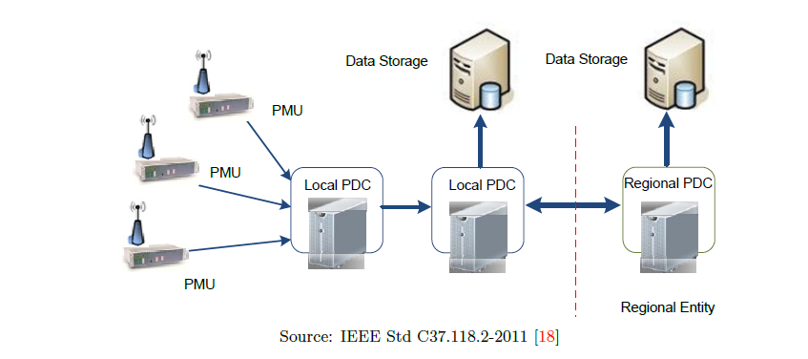
Introduction to Wide Area protection (WAPS).
Presented by : fathy wahed

Slide 2
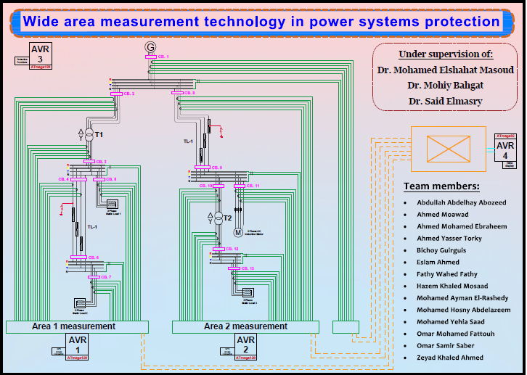
Our project is divided into two main parts:
A- hardware.
B- software.

Slide 3
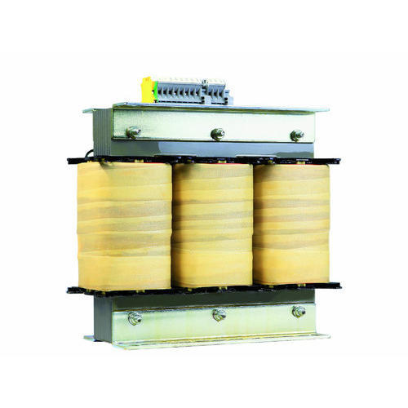
A- hardware divided into :
A- 2 transformers 1.5 MVA :
- We used two transformers that convert the voltage from 380 to 220 volts by a delta connection to a star connection .
- We used the transformers in this MVA to cope with the loads and transmission lines manufactured for this project .

Slide 4
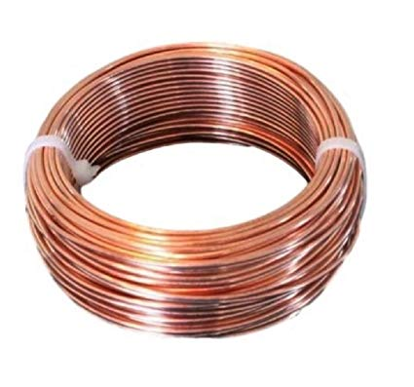
B- 2 Transmission lines :
For the first transmission line the length of the wire is 115 meters and the number of rolls is 332 lps, while it consists of four layers, the DC resistance is equal to 1.7 ohm , and the impedance equals 2.5 ohm , And thus L equals 0.0079577 Henry .
For the second transmission line the length of the wire is 90 meters and the number of rolls of the transformer is 285 rolls, while it consists of three layers, DC resistance equals 2.3 ohm, and impedence equals 3.749 ohm , And thus L equals 0.01193 Henry .

Slide 5
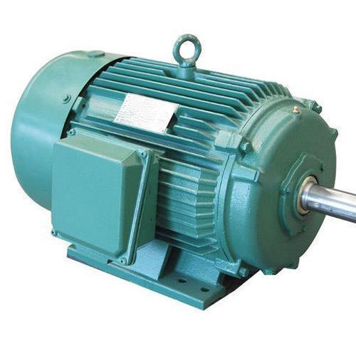
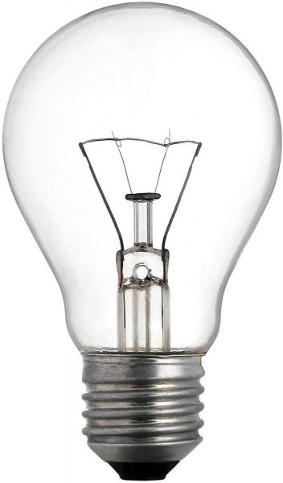
C- 1 three phase induction motor :
- The name of the motor run on 380 volts, rated current has 2 amperes, its capacity is 1 hp .
D- 3 static loads :
- The three static loads have the same power 610 watt.
- Each phase of static load was represented by three lamps with 247-ohm , and to achieve the required resistance equal to 82 ohms , each phase was connected to three parallel lamps .
- All of the above has been done in each phase of three phase of three static loads .

Slide 6
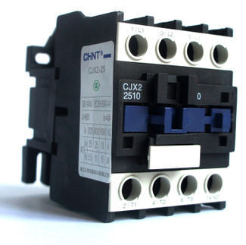
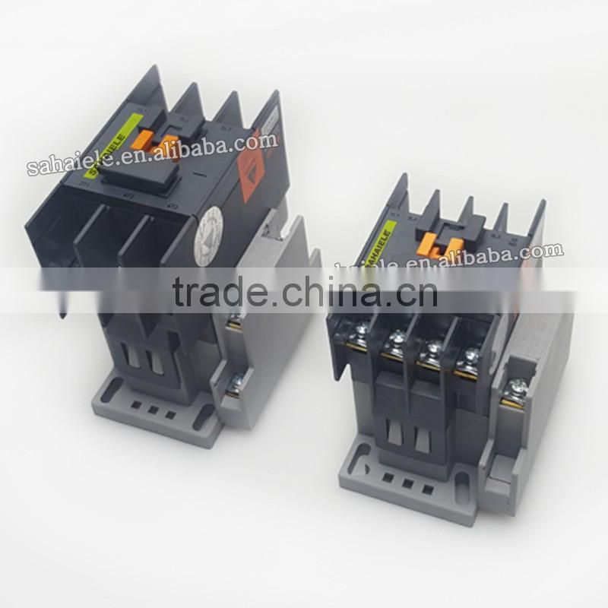
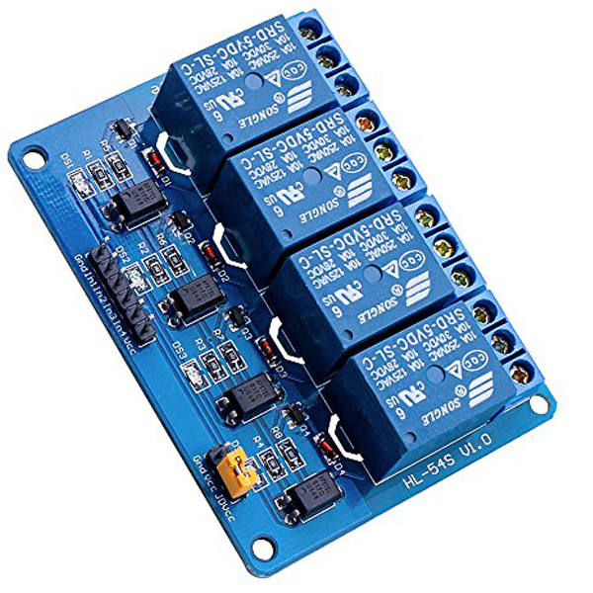
E- 5 three phase contactors :
- 380 volt and 9-ampere were used .
F- 7 three phase contactors :
- 220 volt and 9 ampere were used .
G- We used a kit relay to contact with the contactor and connect the kit with micro controller (ATMEGA 128) .

Slide 7
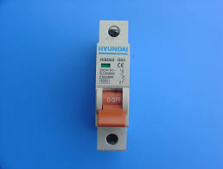
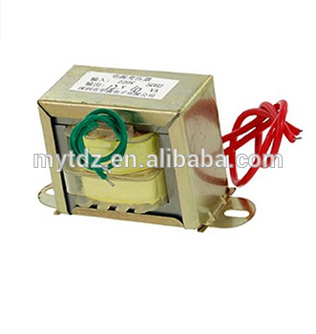
H- we used a three circuit breakers:
- single phase to each phase
before the slag bus 220 volt , 6 ampere .
I- We used 2 voltage transformers convert 400 volt to 5 volt and used 3 voltage transformers convert 250 volt to 5 volt each one installed of each BUS-BAR .

Slide 8
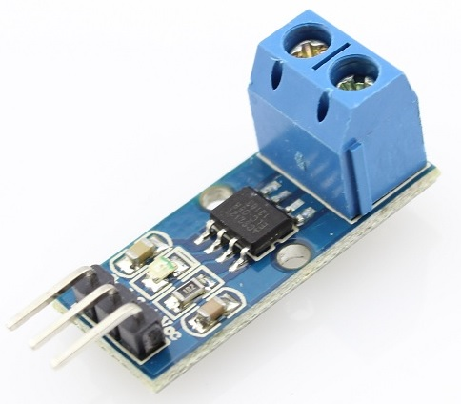
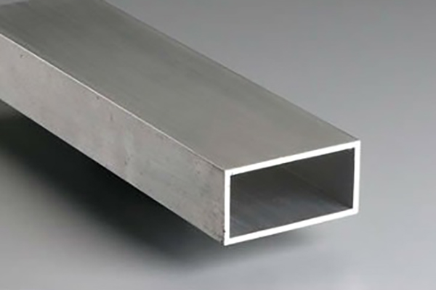
J- We used 36 single phase current sensors:
30 ampere in our project to sense the current and connected with the part of communication .
H- We used 20 Aluminum BUS-BARS on our Graduation project and we used it as collection point .

Slide 9
A- software divided into :
A- 2 microcontroller ( work as a PMU ) .
- They are devices which use synchronization signal from the global positioning system(GPS) satellite and provide the phasor voltage and currents measured at a given substation.
- A phasor is a complex number that represents both magnitude and phase angle of the sine waves found in electricity.
B- 1 microcontroller (work as a PDC ) .
- It is node in a system where phasor data from a number of PMUs or PDCs is correlated and fed out as a single stream to other applications. - PDC would performs the Real time monitoring, alarming, event triggering.

Slide 10
C- human machine interface (HMI):
- We represent it as a touchscreen to display the readings of the system .
D- 1 microcontroller (work as protection function) :
- It is possible to take reads of voltage and current from VT and CS or PMU .
- Note -
-- All the microcontrollers used in the project are ATMEGA128 and this type contains an A / D converter inside it --

Slide 11
How does it work ???????
- The project contains 2 PMUs and each one for one area .
- Its advantage is that it synchronizes the data by time, it is biased by GPSmodule in certain time, then DATA follows the PDC, which collects the data and sends it to the HMI as a display .
-The microcontroller which work as protection functionis read voltage and current And on its basis if fault happen ,it send a signal to kit relay to open the contactor that the fault happen on it .
- Touch screen shows the location of the fault and shows its value

